Slide 1
Organic Chemistry
Introduction

Slide 2
Organic Chem
The study of Carbon molecules
But not:
  Carbon oxides (eg CO₂)
  Metallic carbonates (Sodium Carbonate)
  Hydrogencarbonates (Ammonium Hydrogencarbonate)
8 million organic molecules
Notes:
Organic chemistry is often known as carbon chemistry, as it is the study of carbon and the compounds carbon forms.
But not:
Carbon oxides (CO2)
Metallic carbonates (Sodium Carbonate)
Hydrogencarbonates (ammonium hydrogencarbonate)
Inorganic molecules = 100 000
Organic molecules = 8 000 000 with 300 000 each year

Slide 3
Why so many
Carbon forms stable bonds with itself to make chains.
Carbon forms stable bonds with most other elements.
Carbon forms branched chains.
Carbon forms ring chains.
Carbon forms double bonds.
Carbon forms triple bonds.
Other elements may interrupt the chain.
All of the above may occur together.
Notes:
Following this draw the 1s 2s 2p orbitals on board

Slide 4
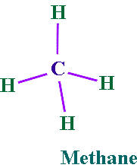
Methane
click this link to see methane
Notes:
Picture of methane demonstrating that C forms 4 bonds (ball and stick and space filled)

Slide 5
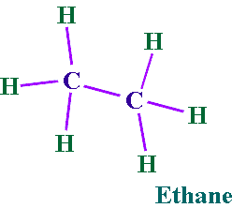
Single bonded Carbon
click this link to see a carbon-carbon single bond

Slide 6
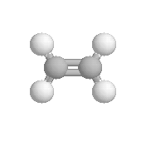
Double bonded Carbon
click this link to see a carbon double bond
Ethene
Notes:
Picture of ethene (ball and stick and space filled)

Slide 7
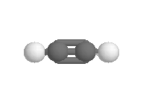
Triple Bonded Carbon
click this link to see triple bonded Carbon atoms
Ethyne
Notes:
Picture of ethyne (ball and stick and space filled)
Get students to answer questions from 21.1 and 21.2

Slide 8
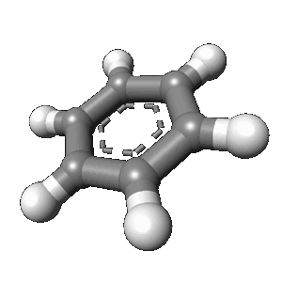
Picture of ring chain
click this link to see a 3D model of Carbon in a ring structure
benzene

Slide 9
End of Slide Show
To Return to Year 12 Tutorial List
Choose Back from Menu above

